Slide 1

An Introduction Of Power BI

Slide 2
Agenda
10,000 Feet view of BI ( Under stand Business Intelligence)
The W Questions
Components of Power BI
Examples , Examples, Examples
Learning Material
Thank you

Slide 3

Would You Like to See the data like below?

Slide 4
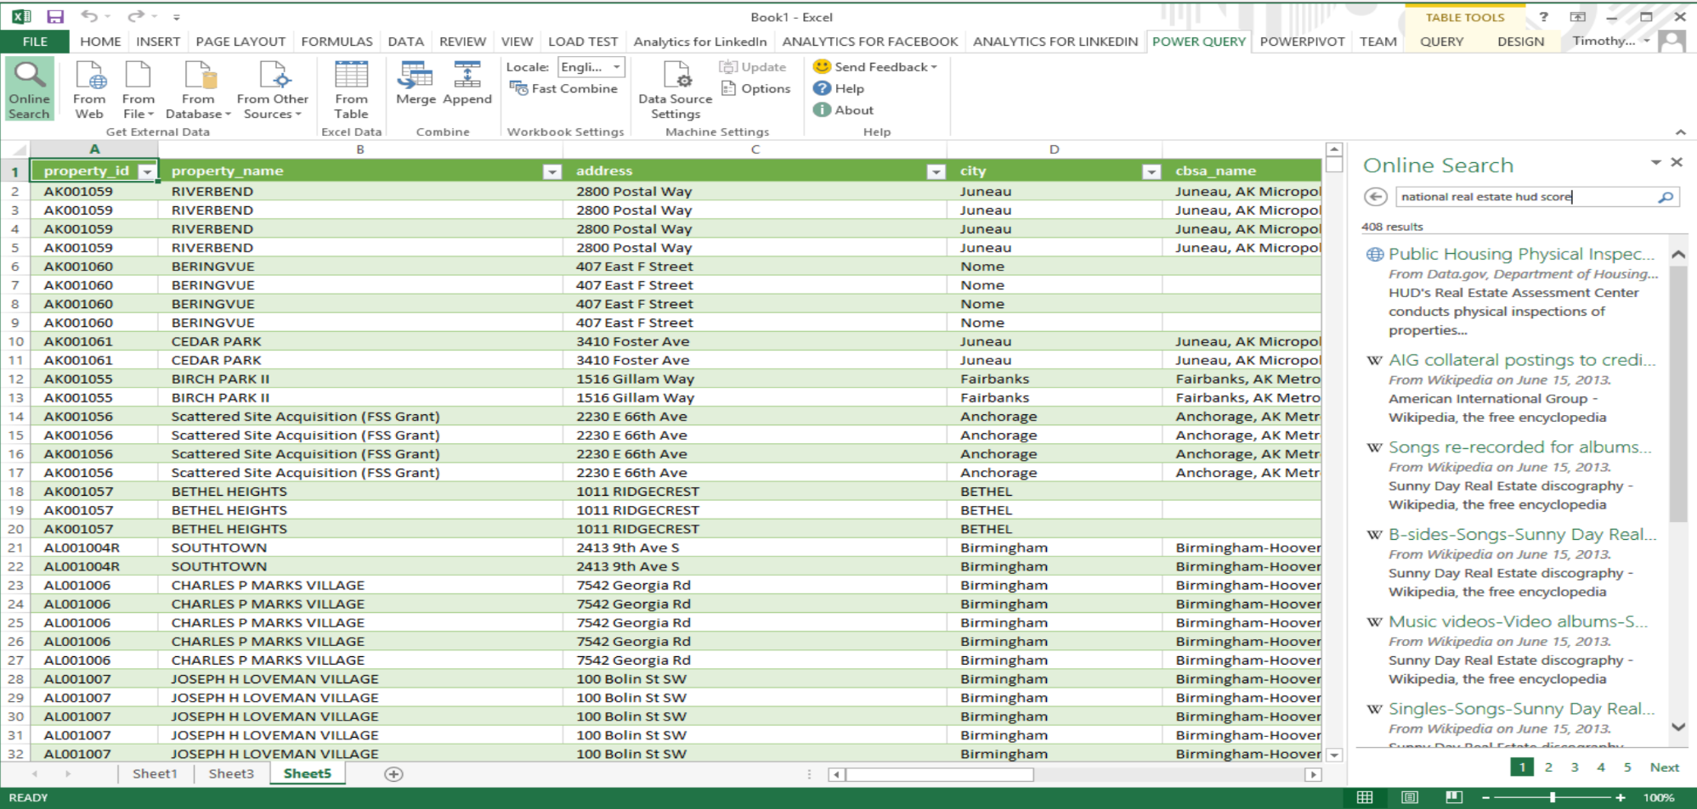
Is it a better way to see ?

Slide 5
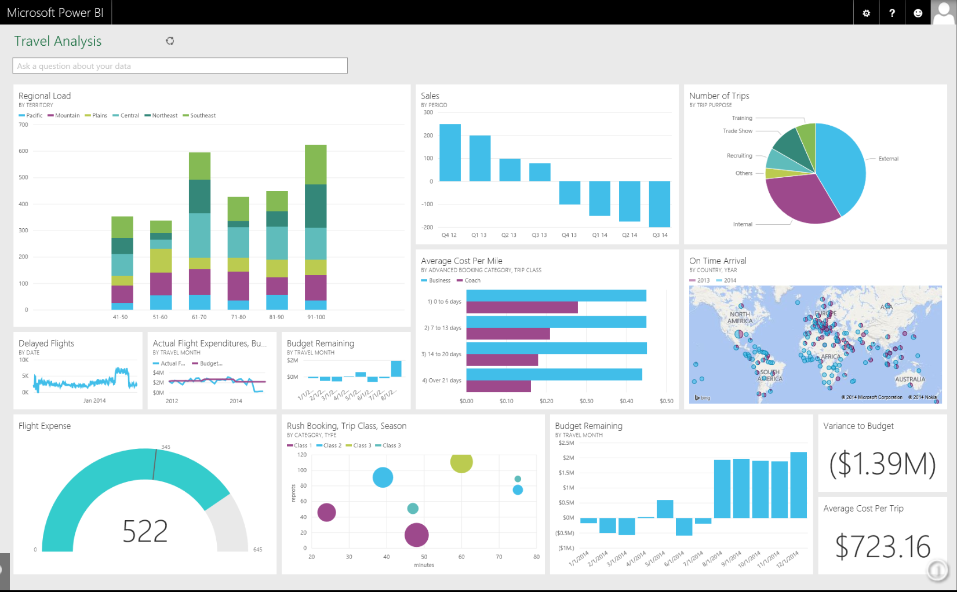
What about this?

Slide 6
Business Intelligence
Timely
Accurate
High-Value
Actionable
Business Intelligence = Technologies + Analysis + Presentation + Helping Decision Making
Notes:
The term Business Intelligence (BI) refers to technologies, applications and practices for the collection, integration, analysis, and presentation of business information. The purpose of Business Intelligence is to support better business decision making.
Insight” does a good job of encompassing the deliverables that flow from a good BI project. This insight plus your organizations industry and business experience will help you make more informed decisions.

Slide 7
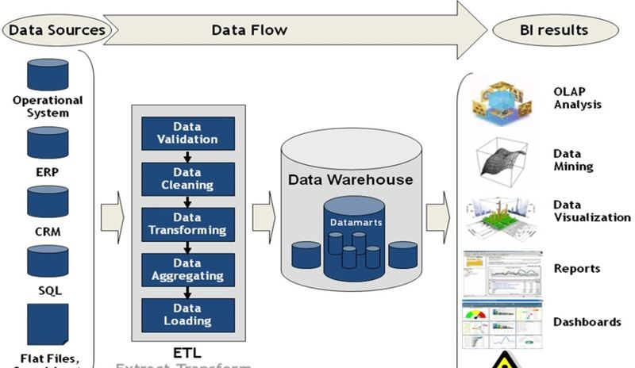
Notes:
Heterogeneous sources
flat file, excel, SQL server ,Oracle etc
SSIS
ABInitio
Informatica
All dataware house are databases
All database may not be dataware houses

Slide 8
W Questions
Why , How , WHAT
Notes:
Why should I learn ?
What is the benefit of learning this?
How should I approach ?

Slide 9
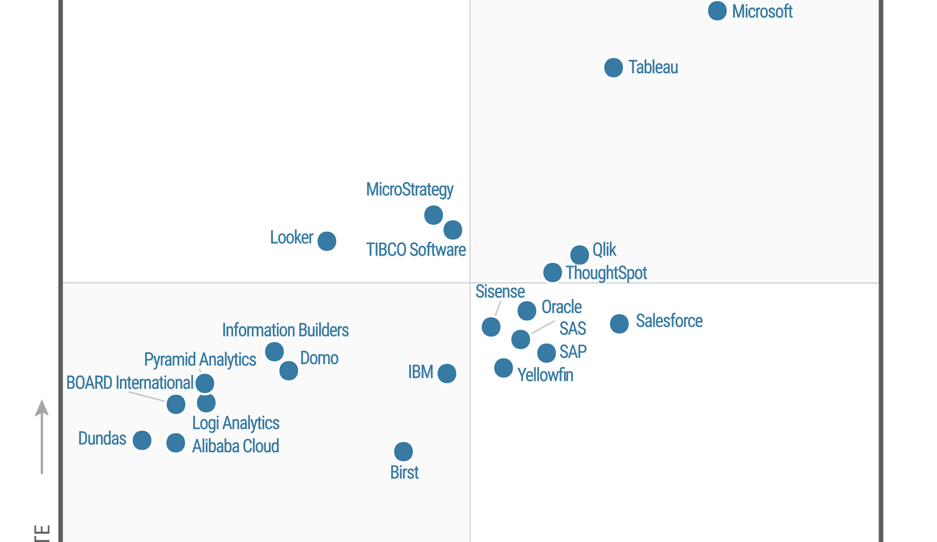
Notes:
2020-gartner-magic-quadran

Slide 10
Starting with Power BI
Our film Start from Here
Notes:
https://community.powerbi.com/t5/Data-Stories-Gallery/IPL-Analysis-The-Criclytics/td-p/156504
https://community.powerbi.com/t5/Data-Stories-Gallery/PUBG-Power-BI-Tool/m-p/349425?advanced=false&collapse_discussion=true&filter=location&location=forum-board:DataStoriesGallery&q=bahubali&search_type=thread
https://community.powerbi.com/t5/Data-Stories-Gallery/Happy-Holidays/m-p/329358
https://community.powerbi.com/t5/Data-Stories-Gallery/Covid-19-Impact-on-Oil-and-Economy/td-p/1332177
https://community.powerbi.com/t5/Data-Stories-Gallery/IPL-Analysis-The-Criclytics/td-p/156504

Slide 11
Power BI IS FOR ?
Power BI
Business Analyst
Developer
You
Me
CEO /CTO
Notes:
A myth is who can use the application.

Slide 12
Power BI
A Self service BI tool
Accessible via Web, Desktop, Mobile
Realtime dashboard updates
Collaboration across your organization
Anyone can use
Intuitive data exploration using Natural Language Query
Fast development , hybrid configuration ,secure
Notes:
Talking points:
Power BI is a cloud-based analytics service that provides faster time to insight. It is used for visualizing, exploring and extracting insights from data. It brings together data from diverse sources to deliver rich, comprehensive views of business operations.
What that means is, with Power BI, you can see all of your data through a single pane of glass, and create an analytics environment in minutes to monitor data and share reports. Live dashboards and reports show visualizations and KPIs from data that reside both on-premises and in the cloud, providing a consolidated view across your business regardless of where your data lives.
There are several capabilities that are unique to Power BI – these include:
Pre-built dashboards and reports for popular SaaS solutions such as Marketo, Salesforce, GitHub, ZenDesk, Dynamics CRM, and many others
Dashboards and visualizations that support real-time updates
Secure, live connection to on-premises data sources to drive insight across the entire range of organizational information (Analysis Services, Azure SQL Database, SQL Database Auditing, Azure SQL Data Warehouse)
Automated scheduled refresh to keep your Power BI data in sync with on premises data sources
Native mobile applications for keeping users connected on the go
Easy integration with other Microsoft offerings, from Excel to Azure services
Intuitive data exploration, which enables users to ask questions of their data in plain English
To summarize, Power BI is a SaaS offering that enables anyone to easily connect to their data, create live operational dashboards and explore data via interactive visualizations

Slide 13
Power BI Parts
Power BI
Power BI Desktop
Power Bi Services
Gateway
Power BI Mobile
Power BI Embeded
Power BI database
Notes:
Power BI desktop – A desktop based free version for connecting t, transforming and visualizing
Power BI service – A web based service for collaboration , sharing , creation of desktop
Power BI mobile – Native application for IOS, Android and windows for viewing report and dashboard
On Premises gateways – An agent installed with corporate network to allow secure access o organizational data source .
Power BI Report server – An alternative to Power BI Service for Deploying Power BI Report on Premises data centre
Power BI Embedded – Api For embedding visual into Custom application

Slide 14
Power BI desktop
Power BI Desktop puts visual analytics at your fingertips with intuitive report authoring. Drag-and-drop to place content exactly where you want it on the flexible and fluid canvas. Quickly discover patterns as you explore a single unified view of linked, interactive visualizations.
Notes:
Use different data source till now 60+ data sources available
Different graphs /Charts / KPI available
Monthly update
Huge collection of
Free downloadable tool
Effortless publishing
Standalone design/development/rendering app with deployment to Power BI Service
Currently integrates:
Power Query
Power Pivot
Power View
* Not all features of each yet, but updates each month, closing the gap
New Power BI Desktop file extension .pbix

Slide 15
Example #1

Slide 16
Example#2

Slide 17
More examples

Slide 18
Other Resources
https://powerbi.microsoft.com/en-us/what-is-power-bi/
https://appsource.microsoft.com/en-us/marketplace/apps?product=power-bi-visuals
https://community.powerbi.com/
https://community.powerbi.com/t5/Forums/ct-p/Forums
http://D3.js
https://community.powerbi.com/t5/Data-Stories-Gallery/bd-p/DataStoriesGallery

Slide 19

Thank you
Rajat Jaiswal (@Rajatjaiswal)
Blogger since 2008 with 12+ years experience
Founder of “Indiandotnet” community group
Microsoft MVP (2015, 2016)
Alibaba Cloud MVP (2018)
Most Valuable Blogger (MVB award)
Microsoft Community Contributor award
Community Lead of Indore Software Community Group & Indiandotnet Group, Indore SQL Pass, Indore Power Platform user Group
http://nerdtechies.com
http://indiandotnet.wordpress.com

Slide 20
